Slide 1

Fragile Base Class - Example
Eamonn de Leastar (edeleastar@wit.ie)
Dr. Siobhán Drohan (sdrohan@wit.ie)
Produced
by:
Department of Computing and Mathematics
http://www.wit.ie/

Slide 2
Fragile Base Class Problem A common problem with Implementation Inheritance

Slide 3
Fragile Base Class
A problem in object-oriented systems.
“Happens when base classes (superclasses) are considered fragile because seemingly safe modifications to a base class, when inherited by the derived classes, may cause the derived classes to malfunction. The programmer cannot determine whether a base class change is safe simply by examining in isolation the methods of the base class.”
https://en.wikipedia.org/wiki/Fragile_base_class

Slide 4
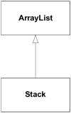
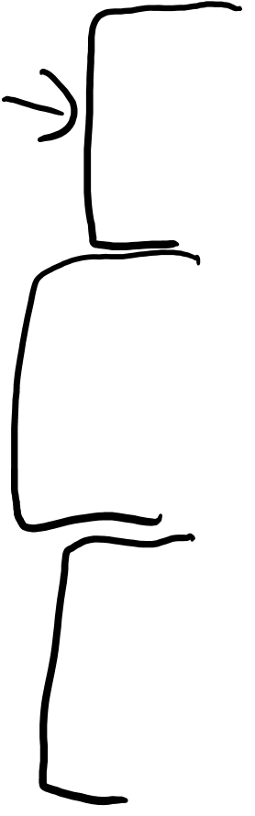
Fragile Base Class Problem
class Stack extends ArrayList
{
private int stack_pointer = 0;
public void push( Object article )
{
add( stack_pointer++, article );
}
public Object pop()
{
return remove( --stack_pointer );
}
public void push_many( Object[] articles )
{
for( int i = 0; i < articles.length; ++i )
push( articles[i] );
}
}

Slide 5
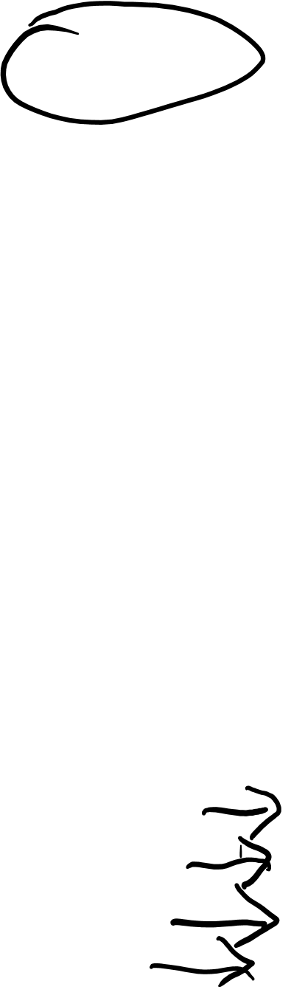
Fragile Base Class Problem
class Stack extends ArrayList
{
private int stack_pointer = 0;
public void push( Object article )
{
add( stack_pointer++, article );
}
public Object pop()
{
return remove( --stack_pointer );
}
public void push_many( Object[] articles )
{
for( int i = 0; i < articles.length; ++i )
push( articles[i] );
}
}
Uses the ArrayList's clear() method to pop everything off the stack
Stack a_stack = new Stack();
a_stack.push("1");
a_stack.push("2");
a_stack.clear();

Slide 6
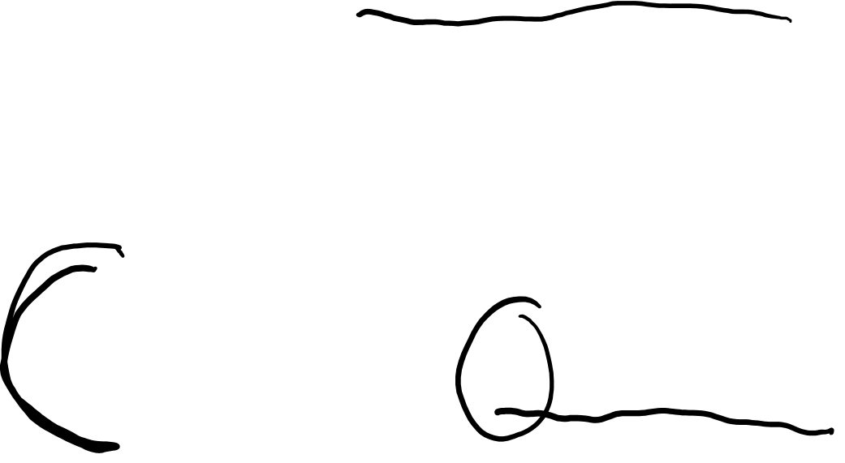
Fragile Base Class Problem
class Stack extends ArrayList
{
private int stack_pointer = 0;
public void push( Object article )
{
add( stack_pointer++, article );
}
public Object pop()
{
return remove( --stack_pointer );
}
public void push_many( Object[] articles )
{
for( int i = 0; i < articles.length; ++i )
push( articles[i] );
}
}
Code successfully executes, but since the base class doesn't know anything about the stack pointer, the Stack object is now in an undefined state.
Stack a_stack = new Stack();
a_stack.push("1");
a_stack.push("2");
a_stack.clear();

Slide 7
Fragile Base Class Problem
class Stack extends ArrayList
{
private int stack_pointer = 0;
public void push( Object article )
{
add( stack_pointer++, article );
}
public Object pop()
{
return remove( --stack_pointer );
}
public void push_many( Object[] articles )
{
for( int i = 0; i < articles.length; ++i )
push( articles[i] );
}
}
The next call to push() puts the new item at index 2 (the stack_pointer's current value), so the stack effectively has three elements on it—the bottom two are garbage.
Stack a_stack = new Stack();
a_stack.push("1");
a_stack.push("2");
a_stack.clear();

Slide 8

Use Composition instead of Inheritance
Inheritance is an “is-a” relationship.
Composition is a “has-a” relationship.

Slide 9
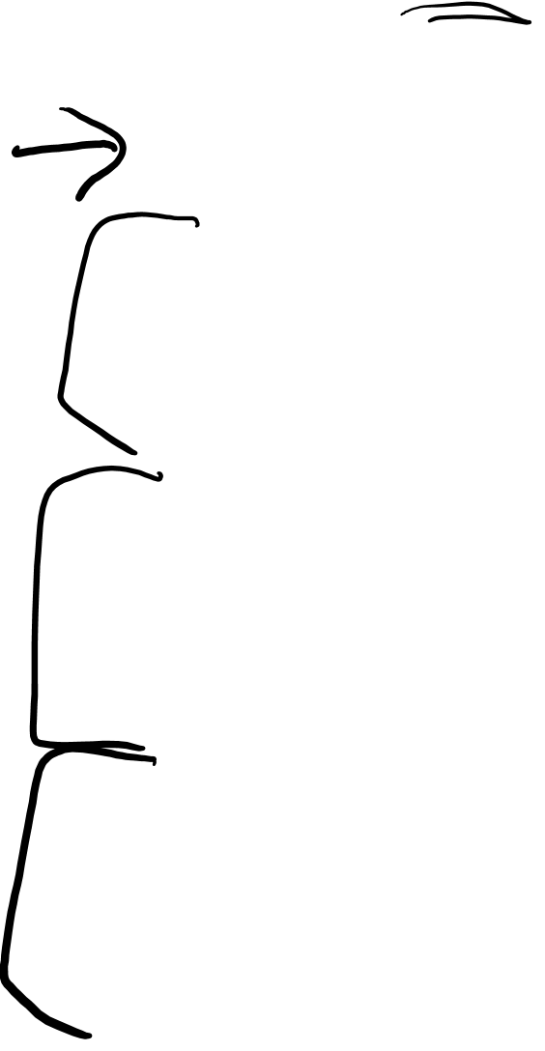
Composed Solution
class Stack
{
private int stack_pointer = 0;
private ArrayList the_data = new ArrayList();
public void push( Object article )
{
the_data.add( stack_pointer++, article );
}
public Object pop()
{
return the_data.remove( --stack_pointer );
}
public void push_many( Object[] articles )
{
for( int i = 0; i < o.length; ++i )
push( articles[i] );
}
}

Slide 10
There’s no clear() method now (so far so good)…. BUT…let’s extend the behaviour…

Slide 11
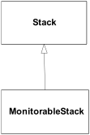
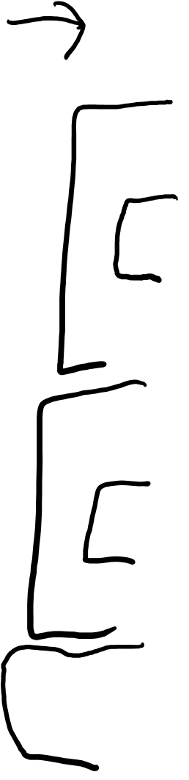
Monitorable Stack
class Monitorable_stack extends Stack
{
private int high_water_mark = 0;
private int current_size;
@Override
public void push( Object article ){
if( ++current_size > high_water_mark )
high_water_mark = current_size;
super.push(article);
}
@Override
public Object pop(){
--current_size;
return super.pop();
}
public int maximum_size_so_far(){
return high_water_mark;
}
}
Tracks the maximum stack size over a certain time period.

Slide 12
push_many Implementation
void f(Stack s)
{
//...
s.push_many (someObjectArray);
//...
}
Stack implements the push_many()method
class Stack
{
private int stack_pointer = 0;
private ArrayList the_data = new ArrayList();
public void push( Object article )
{
the_data.add( stack_pointer++, article );
}
public Object pop()
{
return the_data.remove( --stack_pointer );
}
public void push_many( Object[] articles )
{
for( int i = 0; i < o.length; ++i )
push( articles[i] );
}
}
class Monitorable_stack extends Stack
{
private int high_water_mark = 0;
private int current_size;
@Override
public void push( Object article ){
if( ++current_size > high_water_mark )
high_water_mark = current_size;
super.push(article);
}
@Override
public Object pop(){
--current_size;
return super.pop();
}
public int maximum_size_so_far(){
return high_water_mark;
}
}

Slide 13

push_many Implementation
void f(Stack s)
{
//...
s.push_many (someObjectArray);
//...
}
If f()is passed a MonitorableStack, does a call to push_many()update high_water_mark?
class Stack
{
private int stack_pointer = 0;
private ArrayList the_data = new ArrayList();
public void push( Object article )
{
the_data.add( stack_pointer++, article );
}
public Object pop()
{
return the_data.remove( --stack_pointer );
}
public void push_many( Object[] articles )
{
for( int i = 0; i < o.length; ++i )
push( articles[i] );
}
}
class Monitorable_stack extends Stack
{
private int high_water_mark = 0;
private int current_size;
@Override
public void push( Object article ){
if( ++current_size > high_water_mark )
high_water_mark = current_size;
super.push(article);
}
@Override
public Object pop(){
--current_size;
return super.pop();
}
public int maximum_size_so_far(){
return high_water_mark;
}
}

Slide 14
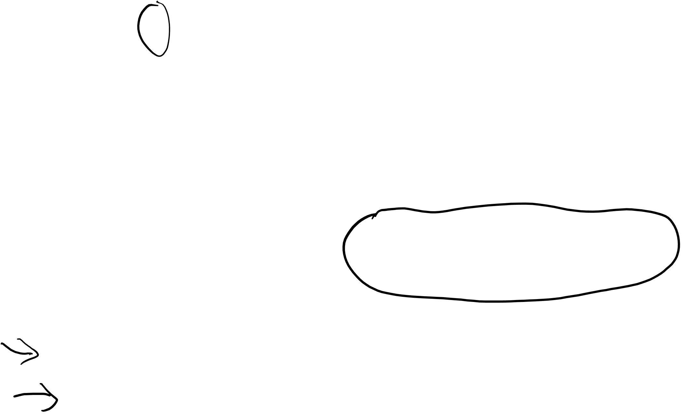
push_many Implementation
void f(Stack s)
{
//...
s.push_many (someObjectArray);
//...
}
Polymorphism ensures that MonitrableStack’s push() method is called, and high_water_mark is appropriately updated.
class Stack
{
private int stack_pointer = 0;
private ArrayList the_data = new ArrayList();
public void push( Object article )
{
the_data.add( stack_pointer++, article );
}
public Object pop()
{
return the_data.remove( --stack_pointer );
}
public void push_many( Object[] articles )
{
for( int i = 0; i < o.length; ++i )
push( articles[i] );
}
}
class Monitorable_stack extends Stack
{
private int high_water_mark = 0;
private int current_size;
@Override
public void push( Object article ){
if( ++current_size > high_water_mark )
high_water_mark = current_size;
super.push(article);
}
@Override
public Object pop(){
--current_size;
return super.pop();
}
public int maximum_size_so_far(){
return high_water_mark;
}
}

Slide 15
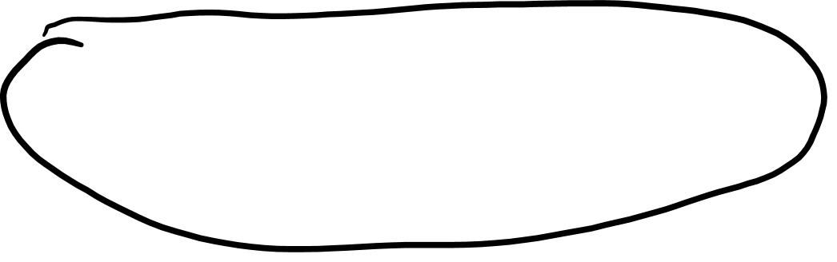
push_many Implementation
void f(Stack s)
{
//...
s.push_many (someObjectArray);
//...
}
This is because Stack.push_many()calls the push()method, which is overridden by MonitorableStack
class Stack
{
private int stack_pointer = 0;
private ArrayList the_data = new ArrayList();
public void push( Object article )
{
the_data.add( stack_pointer++, article );
}
public Object pop()
{
return the_data.remove( --stack_pointer );
}
public void push_many( Object[] articles )
{
for( int i = 0; i < o.length; ++i )
push( articles[i] );
}
}
class Monitorable_stack extends Stack
{
private int high_water_mark = 0;
private int current_size;
@Override
public void push( Object article ){
if( ++current_size > high_water_mark )
high_water_mark = current_size;
super.push(article);
}
@Override
public Object pop(){
--current_size;
return super.pop();
}
public int maximum_size_so_far(){
return high_water_mark;
}
}

Slide 16
Revised Stack
Imagine this scenario:
A profiler is run against an implementation using Stack.
It notices the Stack isn't as fast as it could be and is heavily used.
The base class Stack is improved i.e. rewritten so it doesn't use an ArrayList and consequently it gains a performance boost…

Slide 17
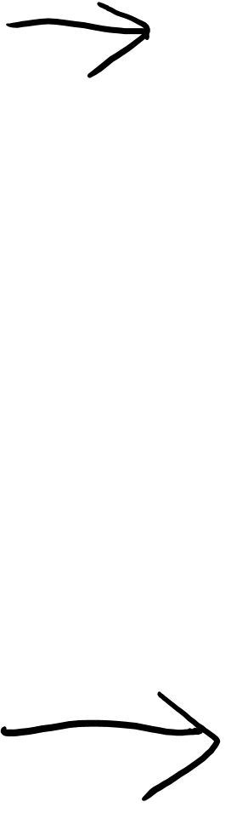
Revised Stack using Arrays
class Stack
{
private int stack_pointer = -1;
private Object[] stack = new Object[1000];
public void push( Object article )
{
assert stack_pointer < stack.length;
stack[ ++stack_pointer ] = article;
}
public Object pop()
{
assert stack_pointer >= 0;
return stack[ stack_pointer-- ];
}
public void push_many( Object[] articles )
{
assert (stack_pointer + articles.length) < stack.length;
System.arraycopy(articles, 0, stack, stack_pointer+1,
articles.length);
stack_pointer += articles.length;
}
}
No longer calls push();

Slide 18
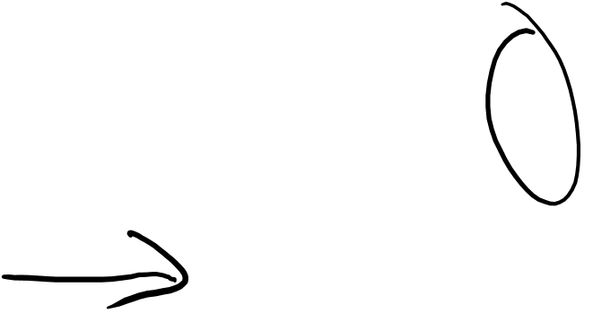
Problems?
void f(Stack s)
{
//...
s.push_many (someObjectArray);
//...
}
If s is a MonitorableStack, is high_water_mark updated?
No – because the new Stack base class push_many() implementation does not call push()at all
LSP Violation: i.e. function f()will not appropriately operate a Stack derived object.

Slide 19
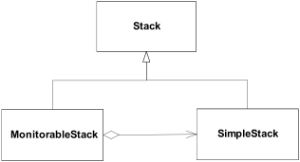
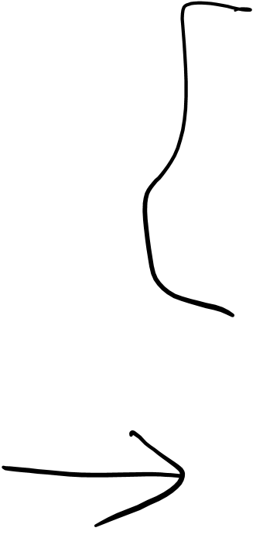
Solution to our Fragile Base Class
interface Stack
{
void push( Object o );
Object pop();
void push_many( Object[] source );
}
MonitorableStack now USES a SimpleStack; it IS NOT a SimpleStack

Slide 20
Delegation / Inheritance Pattern
Create an interface, not a class.
interface Stack
{
void push( Object o );
Object pop();
void push_many( Object[] source );
}

Slide 21
Delegation / Inheritance Pattern
Create an interface, not a class.
Instead of implementing methods at base-class level, instead, provide a “default implementation” of those methods.
interface Stack
{
void push( Object o );
Object pop();
void push_many( Object[] source );
}
class Simple_Stack implements Stack
{
// code omitted
}

Slide 22
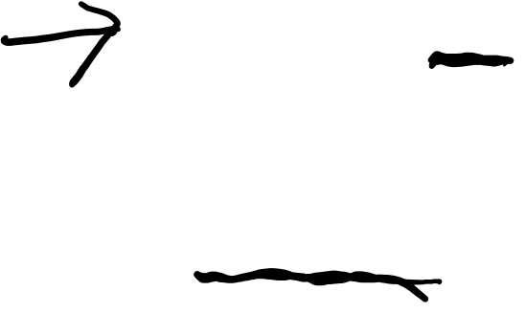
Delegation / Inheritance Pattern
Create an interface, not a class.
Instead of implementing methods at base-class level, instead, provide a “default implementation” of those methods.
Instead of extending the base-class, implement the interface. Then, for every interface method, delegate to a contained instance of the “default implementation”.
interface Stack
{
void push( Object o );
Object pop();
void push_many( Object[] source );
}
class Simple_Stack implements Stack
{
// code omitted
}
class Monitorable_Stack implements Stack
{
private int high_water_mark = 0;
private int current_size;
Simple_stack stack = new Simple_stack();
public void push( Object o ){
if( ++current_size > high_water_mark )
high_water_mark = current_size;
stack.push(o);
}
//code omitted
}

Slide 23

Simple_Stack
interface Stack
{
void push( Object o );
Object pop();
void push_many( Object[] source );
}
class Simple_Stack implements Stack
{
private int stack_pointer = -1;
private Object[] stack = new Object[1000];
public void push( Object article )
{
assert stack_pointer < stack.length;
stack[ ++stack_pointer ] = article;
}
public Object pop()
{
assert stack_pointer >= 0;
return stack[ stack_pointer-- ];
}
public void push_many( Object[] articles )
{
assert (stack_pointer + articles.length) < stack.length;
System.arraycopy(articles, 0, stack, stack_pointer+1,
articles.length);
stack_pointer += articles.length;
}
}

Slide 24
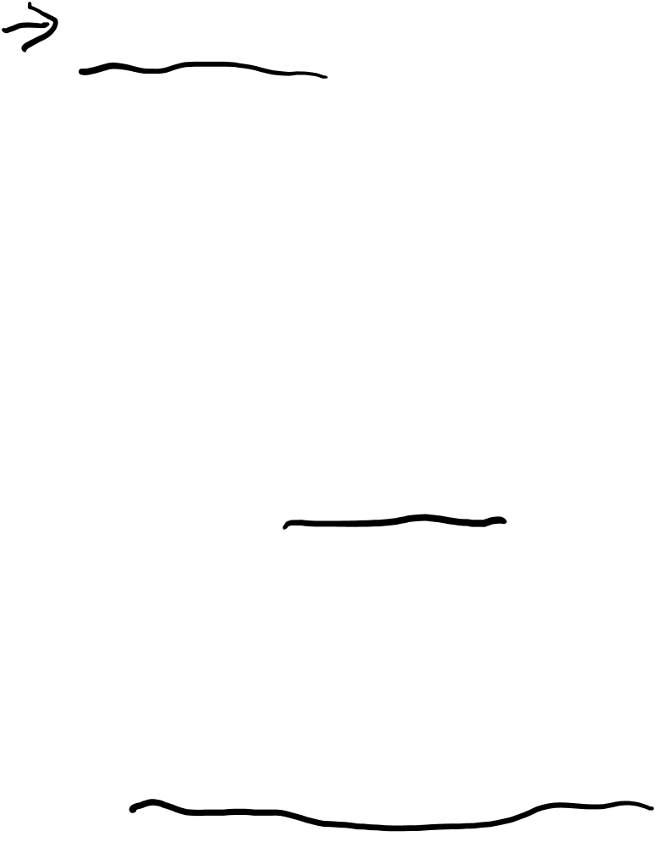
class Monitorable_Stack implements Stack
{
private int high_water_mark = 0;
private int current_size;
Simple_stack stack = new Simple_stack();
public void push( Object o ){
if( ++current_size > high_water_mark )
high_water_mark = current_size;
stack.push(o);
}
public Object pop(){
--current_size;
return stack.pop();
}
public void push_many( Object[] source ){
if( current_size + source.length > high_water_mark )
high_water_mark = current_size + source.length;
stack.push_many( source );
}
public int maximum_size(){
return high_water_mark;
}
}
We delegate to SimpleStack which could be a base class but isn’t.
We are forced to implement push_many which also delegates to SimpleStack.

Slide 25

Holub’s Advice
In general, it's best to avoid concrete base classes and extends relationships in favour of interfaces and implements relationships.
Rule of thumb : 80 percent of code at minimum should be written entirely in terms of interfaces.
e.g. never use references to a HashMap, use references to the Map
The more abstraction you add, the greater the flexibility.
In today's business environment, where requirements regularly change as the program develops, this flexibility is essential.

